Slide 1



R.M.K. COLLEGE OF ENGINEERING AND TECHNOLOGY
News Research Tool for Equity Analysis using langchain.
Alapati Devi Anusha
111620243003
Punuru Divya Harshitha
111620243041
Vadlamudi Lakshmi Tejaswini
111620243056
111620243006
Battepati Dharani
Project Supervisor
Dr. P. Josephin Shermila
Associate Professor
Department of Artificial Intelligence and Data Science

Slide 2


Abstract
The OpenAI-driven Equity Analysis Platform is a web-based tool designed to transform traditional equity research.
Utilizing advanced natural language processing, this platform enables users to input up to four recent links related to a specific company's market and stock trends.
The system utilizes OpenAI's language models to provide accessible and efficient equity analysis through a user-friendly interface with question-answering capabilities.

Slide 3

Objective
Employ OpenAI's advanced language models to meticulously analyze recent online articles, extracting crucial insights related to a specific company's market and stock trends.
Develop a seamless and intuitive web-based interface enabling users to effortlessly input up to four recent links and receive comprehensive analysis and actionable insights.
Implement a robust question-answering system, allowing users to prompt the platform for detailed responses regarding financial prospects, market trends, and potential profitability.
Leverage the sophisticated capabilities of OpenAI's language models to enhance contextual understanding, ensuring precise interpretation of user prompts and nuanced extraction of information.

Slide 4


Introduction
The Equity Research News Tool is a comprehensive language model (LLM) project designed for equity research analysts. Leveraging the power of langchain, the OpenAI API, and FAISS, this tool allows analysts to conduct efficient and insightful news research in the ever-evolving financial landscape.
It uses fancy language models to understand recent news about a company's stocks and market trends.
Just share a few recent links, and the tool will give you insights without the jargon.
Ask questions about profits or losses, and get easy-to-understand answers.

Slide 5
ALGORITHMS
03
OpenAI
01
Langchain
02
FAISS
Utilized for various NLP tasks, such as entity recognition, sentiment analysis, and more, providing valuable insights into the content of news articles. Text generation
Integrated to perform efficient similarity search on precomputed news embeddings, allowing analysts to find articles related to their queries based on content similarity.
Employed to generate human-like summaries or responses, enhancing the tool's capabilities in providing concise and informative outputs. Similarity Search

Slide 6
Paper title
Publications
Merits
Demerits
Technique Used
Artificial Intelligence Applied to Stock Market Trading
Research Gate , 2021
Portfolio optimizaton
The review emphasizes rising interest in AI for finance, covering portfolio optimization, stock prediction, sentiment analysis, and combined approaches
Limited scope in the abstract regarding specific findings, methodologies, or critical evaluation of the reviewed literature.
08 Feb, 2022
Personalized stock investment assistance using real-time machine learning algorithms enhances decision-making efficiency.
Holt–Winters triple exponential algorithm
AI-Based Stock Market Prediction Using Machine Learning Algorithm
Accuracy depends on algorithm reliability, and unforeseen market events may impact predictions; algorithm complexity requires careful implementation

Slide 7
Paper title
Publications
Merits
Demerits
Technique Used
A Novel AI-Based Stock Market Prediction Using Machine Learning Algorithm
2022
Limited scope in the abstract regarding specific findings, methodologies, or critical evaluation of the reviewed literature.
efficient market hypothesis
Machine learning algorithms use complex logic to observe and learn the behavior of stocks using historical data which can be used to predict future movements of the stock. Technical indicators such as rolling mean, momentum, and exponential moving average are calculated to convert the data into meaningful information
Application of Artificial Intelligence in Stock Market Forecasting: A Critique, Review, and Research Agenda
2021
hybrid-neuro techniques
used successfully to study and analyze stock market activity
Accuracy depends on algorithm reliability, and unforeseen market events may impact predictions; algorithm complexity requires careful implementation

Slide 8
Existing Model
The current landscape of equity analysis tools features several models that share a common approach—requiring users to manually input text for analysis.
In this paradigm, users copy and paste relevant content into the model, which then performs an in-depth analysis and provides actionable results.
However, it's important to note that these models often come with constraints, including text limits or word count restrictions, which can impact the breadth and depth of the analysis.

Slide 9
Proposed Model
Our groundbreaking equity analysis model introduces a significant departure from conventional methods.
Unlike existing models requiring manual copy-pasting of entire articles, our approach simplifies the process. Analysts only need to paste the links to recent articles about a specific company.
The model autonomously accesses the provided links, analyzes the entire articles using advanced technologies like Langchain for NLP tasks and the OpenAI API for text generation.
This innovation not only enhances efficiency by eliminating manual input but also offers a more streamlined experience for research analysts.

Slide 10

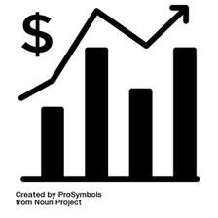


Vs
ChatGPT
OUR MODEL
Instead of copy pasting endless amount of text from stock market related articles , we can just copy paste the links in the prompt ,which eventually clears the disadvantage of word limit
our model can have the ability of accessing the content inside the links through internet browsing
one can give 3-5 links as the prompts to the model , after analyzing all the links the model will even output that particular link from which it got the output
In chatgpt there will be a word limit ...we can only copy paste only 300 words at a time
ChatGPT cannot directly access or interact with links that you copy and paste into the conversation. It operates based on the text input it receives and doesn't have the ability to browse the internet or access external content such as links.

Slide 11

GOOGLE
OUR MODEL
VS
Provides real-time stock quotes and financial news.
Offers interactive charts for technical analysis.
Integration with Google Sheets for custom analysis tools.
Advanced data analysis capabilities.
Predictive analytics for forecasting stock prices.
Sentiment analysis to gauge market sentiment.

Slide 12
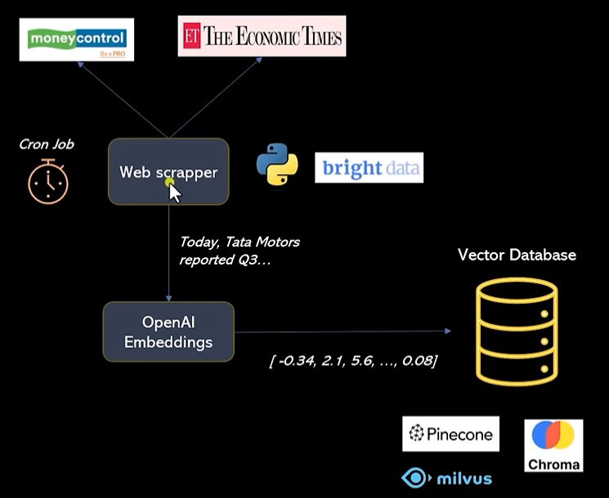
DATA INGESTION SYSTEMt

Slide 13
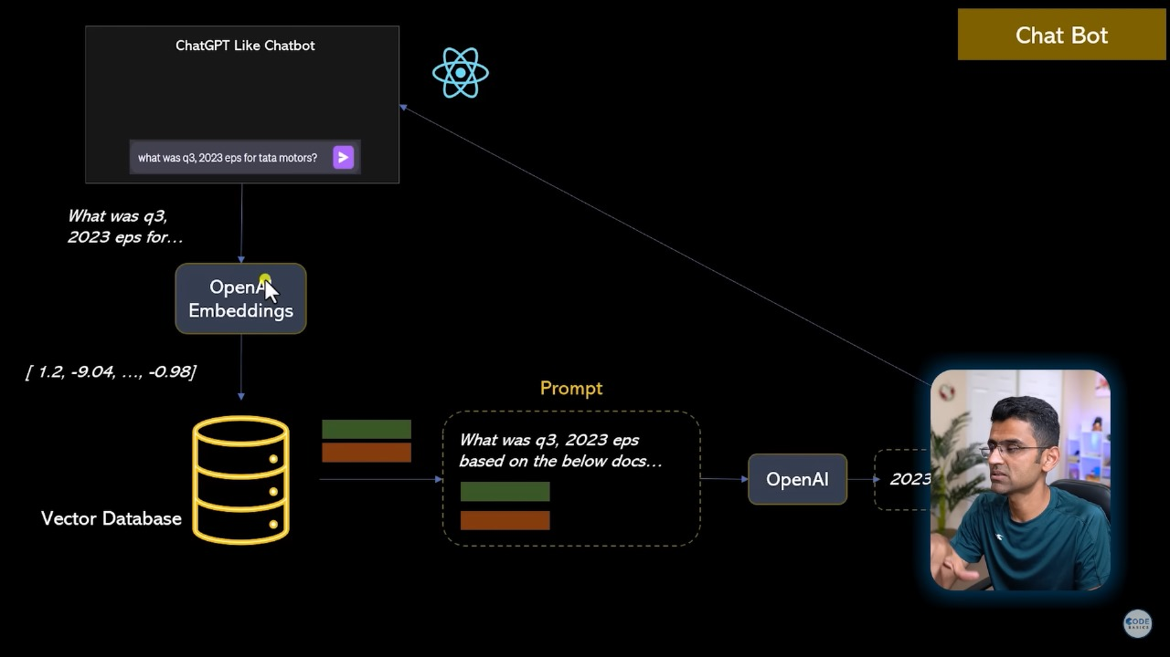



Slide 14

ARCHITECTURE
1
DATA LOADING
2
TEXT SPLITTING
3
EMBEDDING GENERATION
VECTOR STORAGE
4
5
ANSWERING QUESTIONS

Slide 15
Hardware Requirements
Software Requirements
Processor : >i3 configuration
Installed RAM :>8.00 GB (7.84 GB usable)
System type: 64-bit operating system, x64-based processor
langchain
openai
streamlit
unstructured
tiktoken==0.4.0
faiss-cpu==1.7.4
libmagic==1.0
python-magic==0.4.27
python-magic-bin==0.4.14

Slide 16


ROADMAP
10 - 2 -24 MODEL SELECTION Choosing an appropriate algorithm.
25 - 1 - 24 DEFINE THE PROBLEM Analyzing the problem and choose the best solution.
5 - 2 -24 DESIGN ARCHITECTURE Gathering data regarding problem statement for the ML model
20 - 2 -24 TRAIN THE MODEL Feeding the data to model and making it learn.
30 - 2 -24 DEPLOYMENT First, accuracy measurement. Second, make model available to users.
5
4
3
2
1

Slide 17
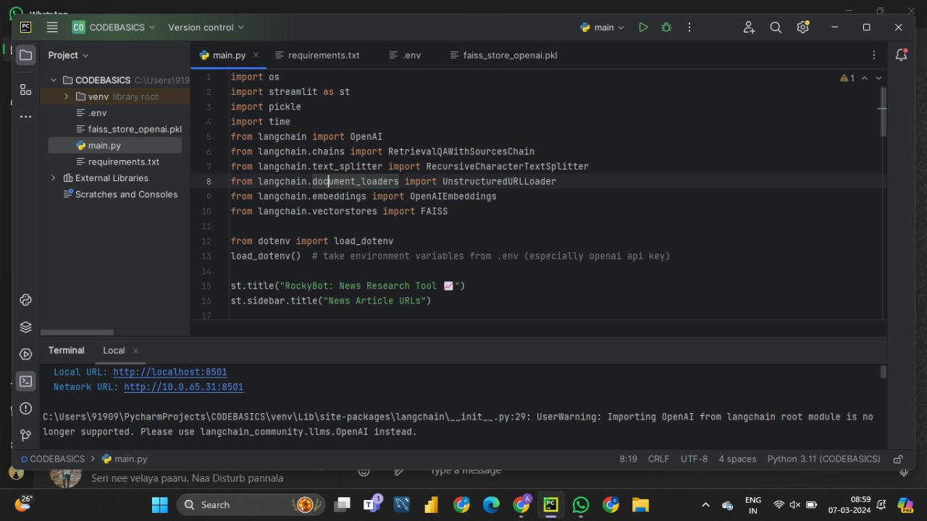
Code Implementation

Slide 18
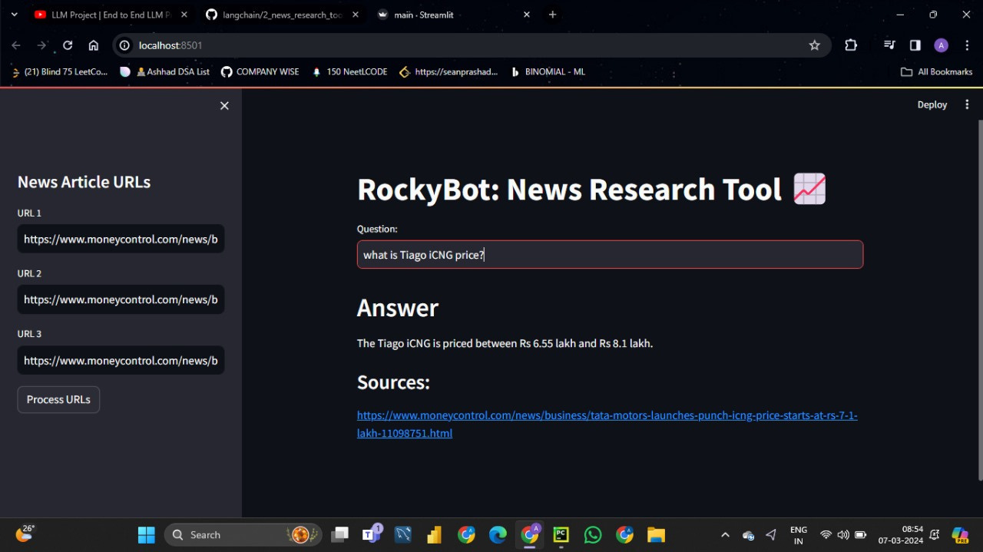
Model Interface and Output

Slide 19
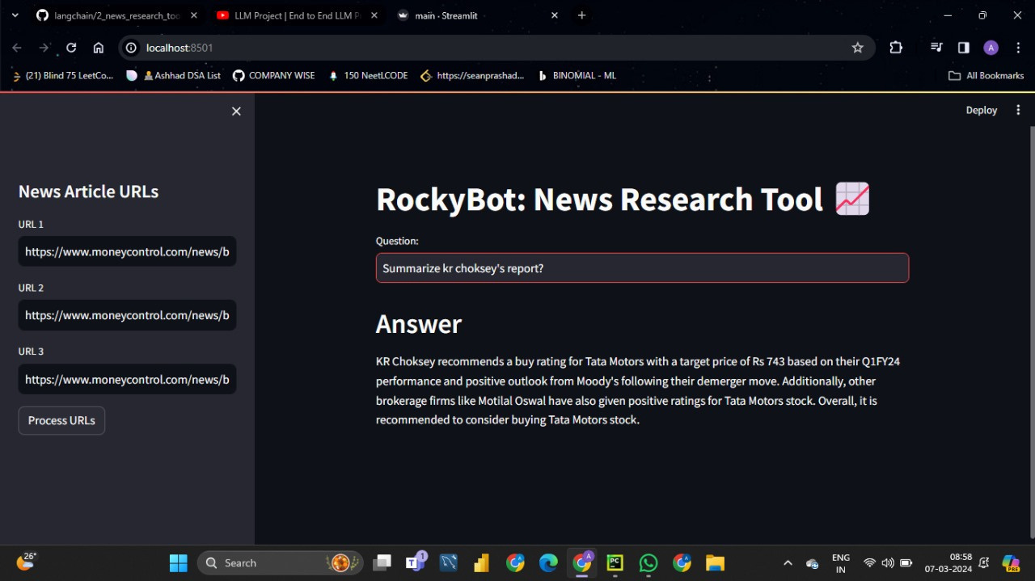

Slide 20
CONCLUSION
The "Invest IT Bot: News Research Tool" facilitates users in extracting information from provided URLs through sophisticated NLP techniques. It answers user queries directly from the analyzed content and provides the source link for transparency and further investigation, enhancing user experience and knowledge acquisition.

Slide 21
REFERENCES
[1]
Fernando Ferrari, Amir H Gandomi, “Artificial Intelligence Applied to Stock Market Trading” 2021 IEEE. https://ieeexplore.ieee.org/document/9350582
[2]
Sohrab Mokhtar, Kang K Yeni, Jin Liu, “Effectiveness of Artificial Intelligence in Stock Market Prediction Based on Machine Learning”, International Journal of Computer Applications 2018. https://arxiv.org/pdf/2107.01031.pdf
[3]
Iyyapam, Afraj Alom, “A Novel AI-Based Stock Market Prediction Using Machine Learning Algorithm” , 2022. https://www.hindawi.com/journals/sp/2022/4808088/

Slide 22
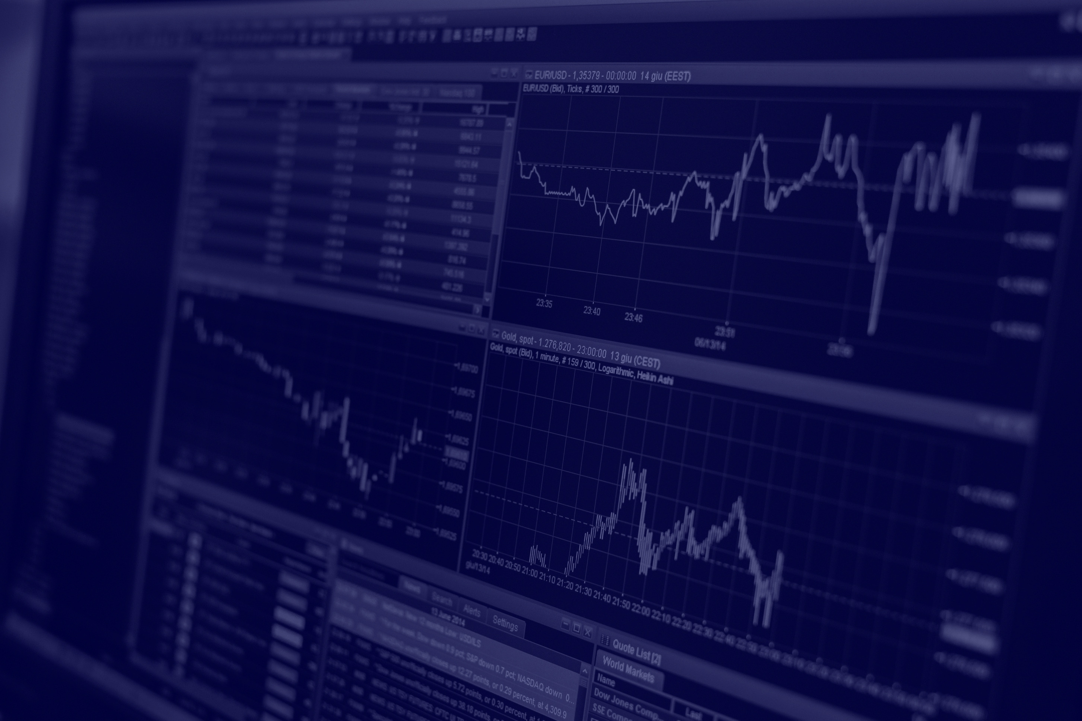

Thank
You

